Slide 1
Natural Interaction in Asymmetric Teleconference using Stuffed-toy Avatar Robot
Samratul Fuady, Masato Orishige, Li Haoyan,
Hironori Mitake, Shoichi Hasegawa
Tokyo Institute of Technology

Slide 2
Introduction
Emerging research on improving the experience and interaction in telecommunication
Telepresence/telexistence : enabling user to feel his/her presence in a different location from the true location
Natural Interaction : nonverbal channel
  Emotional Feedback : Facial expression
  Envelope Feedback : Gaze, beat gesture, head movement
    more significant compare to emotional feedback (Cassell,1999)
[1] J. Cassell, K. R. Thorisson, “The power of a nod and a glance: Envelope vs emotional feedback in animated conversational
agents“, Applied Artificial Intelligence Vol.13, 4, 1999
Notes:
Nowadays, the research on improving the experience and interaction in telecommunication receiving a lot of attention.
In old time, communication only through audio, then the era of video call come, and now it comes even further. People wants to physically present and interact with their partner in another location.
The term telepresence or tele existence then become popular. Basically, it is a system that enabling user to feel his/her presence in different location from their true location.
We all know in communication, we don’t only exchange word. A lot of study suggested that more than 50% of communication is through non verbal channel, your expression, body language, gesture, and soon.
To have natural interaction we need to consider this part.
It can be devided into emotional feedback and envelope feedback.
Of course it will be better if you have both. But in the case if there is restriction here and there and you need to choose. Envelope feedback is more significant. Its more like necessary condition to have good communication.

Slide 3
Introduction (cont’d)
Teleconference :
  Symmetric : both remote user and local user have same experience
  Asymmetric : different experience
    Avatar Robot as a remote user’s substitute in local environment
    Importance of direct-physical interaction
    Only some member of the group that can’t join conference
Our goal
  Facilitate the remote user to appear in the conference, and interact naturally using reasonable equipment without immersing the remote user into virtual environment
  Transmit the remote user’s envelope feedback to the avatar robot as it is
  Enhance the interaction in the local side
Notes:
Considering the experience fell in each side, teleconference system can be devided itu symmetric and asymmetric case.
Symmetric : example
Asymmetric
Why? Something real that you can talk to, you can touch, and you can hug.
This remote user is usually the person who is travelling. And they don’t want to bring heavy equipment. So sometime it is not realistic to force both side have the same experience.
So, our goal in this system is

Slide 4
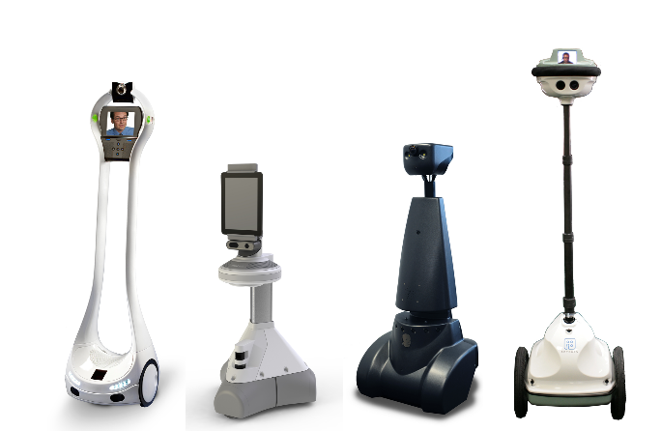
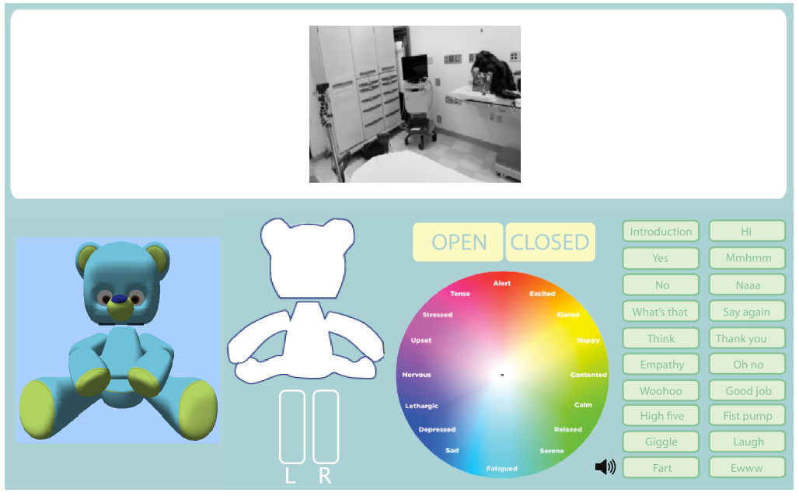
Related Works
Commercially available telepresence mobile robots
  Anybots, Doublerobotics, Mantarobot, etc.
  “Walking monitor”
J.K. Lee, et al. (2008) and S. Jeong, et al.(2015)
  Develop semi-autonomous robot avatar for family communication, education, and pediatric care
  Lack of natural interaction from the remote user side
[2] J.K. Lee, et al., “The Design of a Semi-Autonomous Robot Avatar for Family Communication and Education,” IEEE Int. Symp. on
Robot and Human Interactive Communication, 2008
[3] S. Jeong, et al., “Designing a Socially Assistive Robot for Pediatric Care,” Proc. Int. Conf. on Interaction Design and Children, 2015
Notes:
Several telepresence mobile robot has been available commercially. For example Anybots, double robotics, mantarobot, and so on.
The robot is very helpful to give remote user more access to local environment by the ability to move, but the interaction that can be done is very limited since it basically just walking monitor.
Another telepresence system has been developed by MIT Media Lab, the concept and design was already there since 2008 but fully implemented in 2015. They develop bear-like semi autonomous robot avatar for family communication, education, and pediatric care.
The good interaction can be achieved in local side, we can see the kids can play with the robot, but in the remote user side, the interaction is not natural, since the user need to select the response or emotion manually

Slide 5
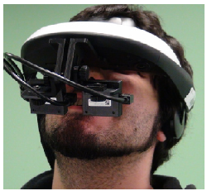
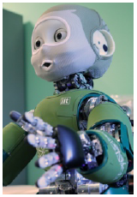
Related Works (2)
Beaming Project (2015)
  Using HMD and eye-tracker to capture remote user movement and transfer those to the robot.
P.W. Ching, et al. (2016)
  Develop anthropomorphic
  robot, use Kinect sensor and
  wearable hand glove to capture
  remote user movement
  Robot’s hard mechanism
  decrease interaction in local side
[4] G. Baily, et al., “Beaming the Gaze of Humanoid Robot,” Human Robot Interaction, 2015.
[5] P.W. Ching, et al., “Design and Development of EDGAR – A Telepresence Humanoid for Robot-mediated Communication and Social
Application”, Proc. Int. Conf. on Control and Robotics Engineering, 2016.
Notes:
Other related research is Beaming Project on 2015. They use HMD…
They only focusing on head and eye gaze movement, eventhough the hand movement can be added quite easily. The main difference with our research is, they immerse the user in virtual environment (which is the local environment captured by camera), so remote user can act naturally. In our case, we try not to put the user into virtual environment, but still facilitate their natural interaction
The most current research is done by Being there center in NTU Singapore on this year. They develop…. As for face, they backproject user face into rbot face.
Unfortunately, the hard mechanism they use for robot can decrease the interaction to local user as we can see in the video. Setting is not convenient because they use kinect

Slide 6
Proposal
Facilitate the remote user to appear in the conference, and interact naturally using reasonable equipment
Transmit the remote user’s envelope feedback to the avatar robot as it is
Enhance the interaction in the local side
Capture user’s gesture and gaze using wearable motion sensor and eye gaze tracker
Transform user’s movement to robot’s movement in real time over network
Use stuffed-toy robot as avatar

Slide 7
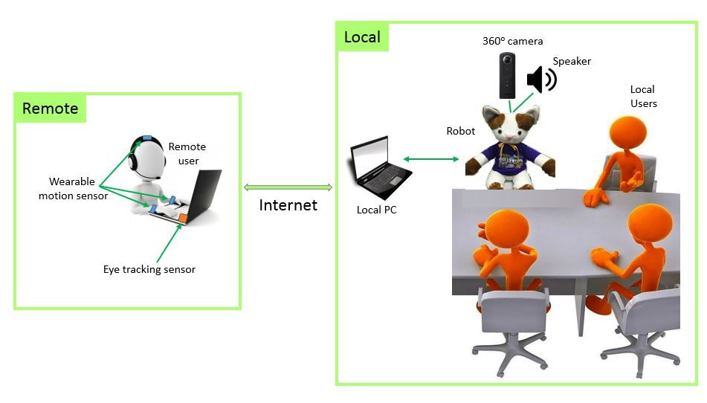
System Overview
Local
Remote
Notes:
So, this is the overview of the system we developed.
On the remote side we have remote user equipped with eye tracking sensor and wearable motion sensor.
On the local side, we have the avatar robot, local user, and theta camera to capture whole local environment. So user can see the wide range of local environment.
The recorded movement capture by motion sensor will be translated to robot movement, and the captured eye movement will be translated as robot head movement according to what the remote user focus on.

Slide 8

System Overview
Local
Remote
Local PC
Remote PC
Data Transformation to Head and Arms Angle
Wearable motion sensor
Sensor reading and reformatting
Data receiver, converter, and buffering
Eye Tracking Sensor
Sensor reading and display
Interpolation
Robot
Internet
Theta 360⁰ camera
Speaker

Slide 9
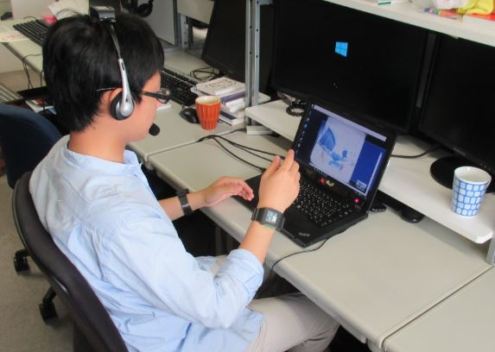
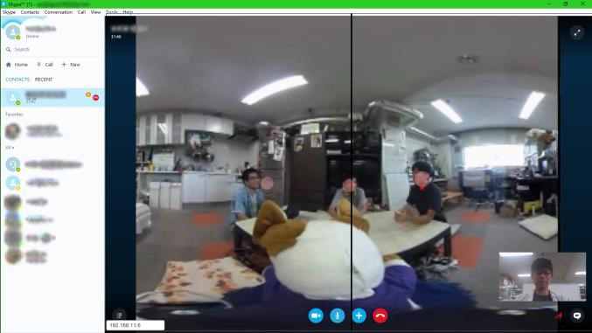
Remote Side
Capture the angular velocity of remote user’s movement
  Using wearable motion sensor (ROHM SensorMedal-EVK-001)
Capture remote user’s eye movement
  Tobi EyeX attached to PC
Video call using available application (ex. Skype, Hangout, etc) and additional application to capture and send data.
Notes:
This approach is quite different with common teleoperated robot. Where they usually consider the position and do position control in the robot.
This is different when you want to show gesture. In human, when we talk with our partner, usually we focus on eye, and the gesture happen outside our focus. And this is captured by peripheral vision which is more responsive to velocity.

Slide 10
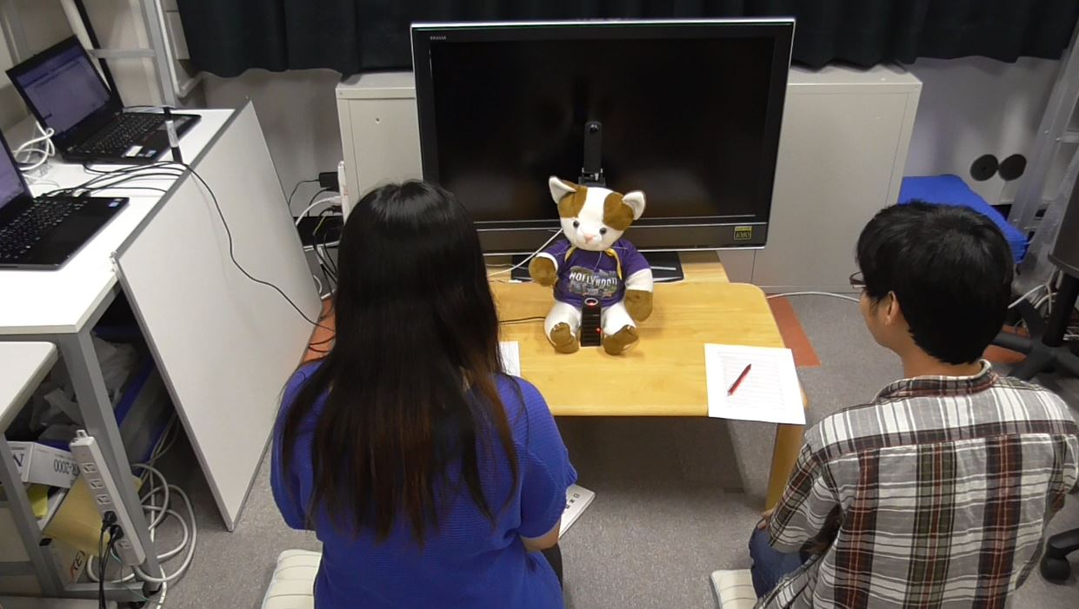
Local Side
360⁰ camera placed behind robot to capture whole environment
Transform the movement
  Remote user’s arm and head movement → robot’s arm and head movement
  Eye movement → turning angle of robot’s head

Slide 11
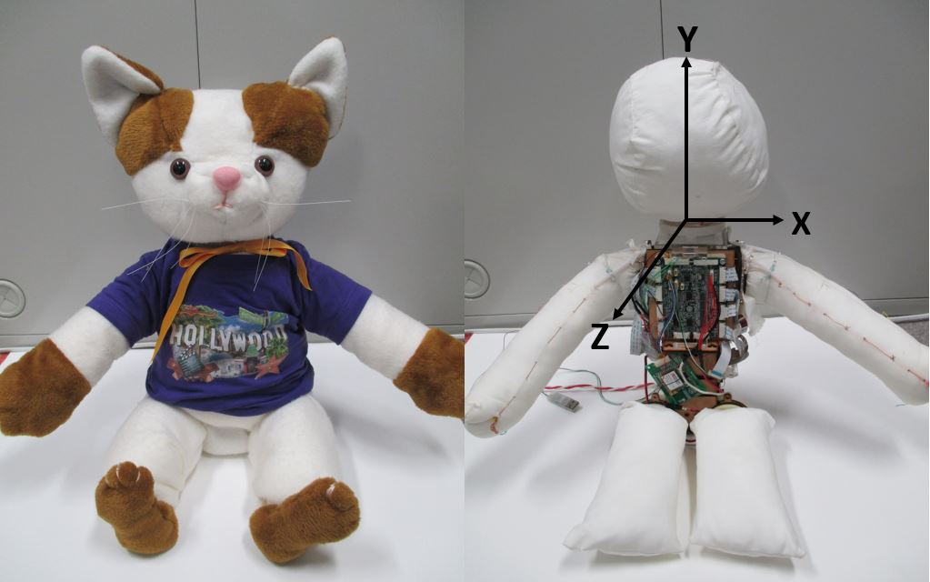
Stuffed-toy Robot
Neko-chan is built using cotton-based soft material for the moving part
  Improve familiarity, safety, and user interaction compared to robot with hard material and mechanism
  Durability
  Fast movement (speed:4.04rad/s, cf. Nao:3.29rad/s, iCub:1.25rad/s)

Slide 12
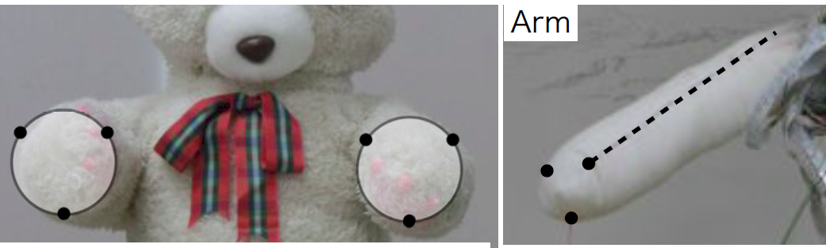
Stuffed-toy Robot : Motion
Each moving part has 3 strings attached to it
Developing equation model for this mechanism is difficult.
  A lot of factors can affect the characteristic of the moving parts
Notes:
By pulling and releasing sting in combination, it can move to any direction in 3D space.
The problem with this mechanism is
Like the shape of the cotton bag, the cotton fill, the stitching, and many other factor.

Slide 13
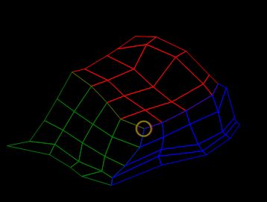
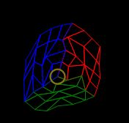
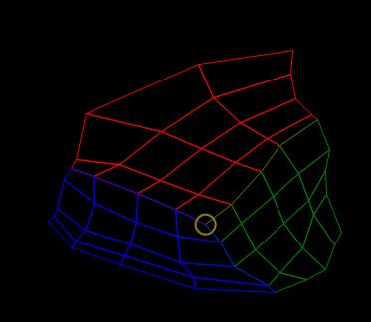
Stuffed-toy Robot : Motion
Collecting map data by pulling each string bit by bit and recording the position
Trajectory planning is performed using interpolation from collected map data
For smoother motion : Interpolation between poses
Map data : Right Arm – Front View
Map data : Head – Top View
Map data : Left Arm – Front View
Notes:
So if we want the robot to move to any target point. We interpolate that point to the map, and we can get the required length of string to go to that target position

Slide 14
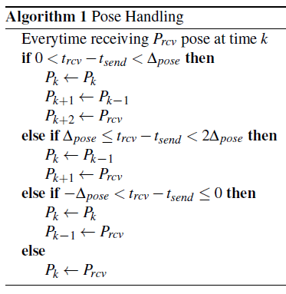

Stuffed-toy Robot : Packet Data
Real-time movement
Buffer is created to handle network uncertainty
Stores $n_{pose}$ robot poses with $Δ_{pose}$ interval
  ↑${ n}_{pose}$ : high latency
  ↓${ n}_{pose}$ : risk of lack of data
  ↑ $Δ_{pose}$ : high latency & risk of
  missing high-frequency
  movement
  ↓ $Δ_{pose}$ : unsmooth robot movement
Notes:
In teleconference system, the movement need to be performed in real time. To handle network uncertainty, we store the target pose temporarily in the buffer.
The buffer is continuously updated every time the new pose arrived, and some update rule is implemented to handle unwanted cases.

Slide 15
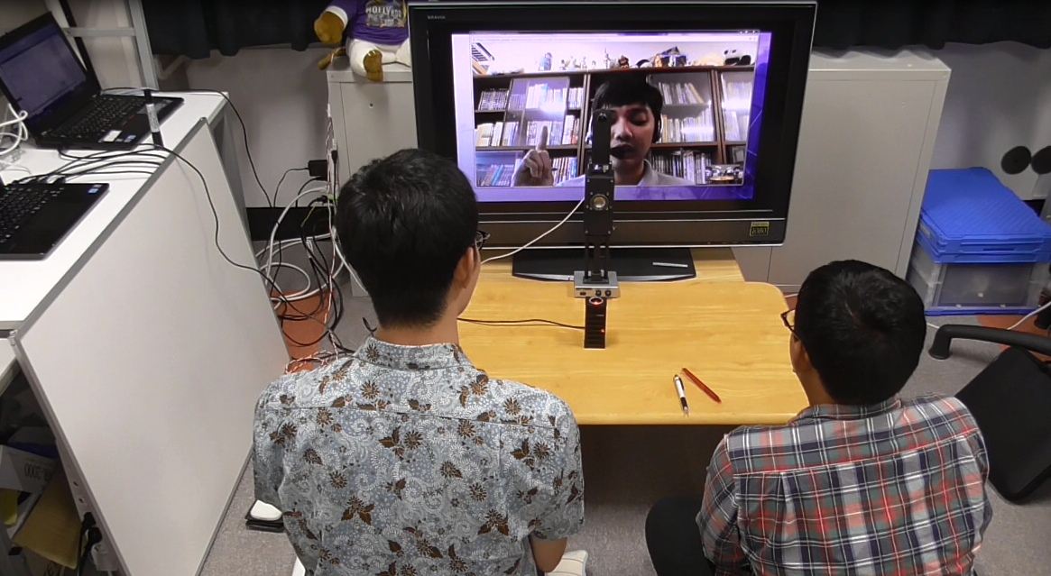
Experiment
Two Sessions
  Conventional video conference
  Stuffed toy robot
10 participants (6 men and 4 women, 23 - 35 years old)
Remote user asked several questions to participant in random turn
Evaluation in local side

Slide 16
Result : Observation
We observed participants response when the remote user asks or talk to one of them without mentioning their name
Participants get confused in
  Video conference : 15 out of 30 times (50%)
  Avatar Robot : 3 out of 30 times (10%)
This confusion reduces communication smoothness, because remote user and participants need to do repetitive confirmation to solve the problem.

Slide 17
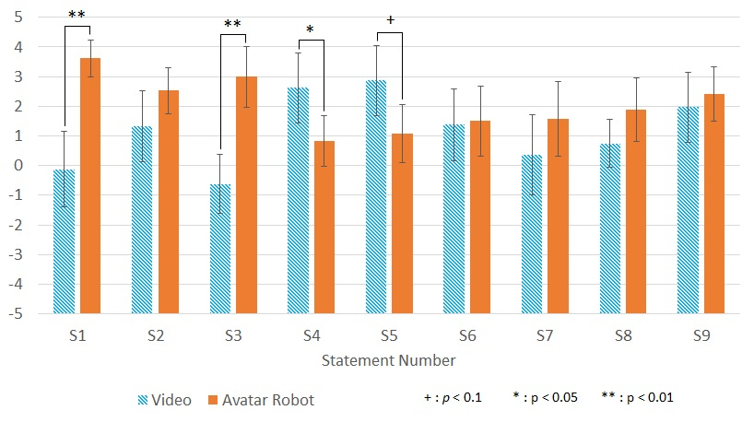
Result : Questionnaire
At the end of each session, participants are asked to fill Questionnaire and rate their impression with Visual Analog Scale (VAS)

Slide 18
Result : Questionnaire
S1. I easily understand who the remote user is talking to
S2. The turn taking of speaking during the conversation was easy for me
Notes:
Statement 1 and 2 which is related to taking the turn in speaking receive very good impression when using stuffed-toy robot. We found significant difference of how easy to understand to whom the remote user is talking, by using the robot compare to video conference.
The ability of the robot to turn its head while speaking to the corresponding person make it easier to communicate in a conference situation, where two or more people are involved.
This experience is quite difficult to perform in a conventional video conference because participant can't easily tell who the remote user is talking to. The video of the remote user always shows his/her eyes staring at the display monitor, making it tough to distinguish where the remote user are looking at, even though the remote user actually looks to a particular person in his/her display monitor.

Slide 19
Result : Questionnaire
S3. The gesture of the remote user/robot is easy to understand
Notes:
Next is about the beat gesture of the robot which also shows significant difference.
In the case of the video conference, even though the upper part body (head and part of arms) of the remote user is visible to the participants (captured from embedded camera on the PC), the participants tend to really focus on the face. Capturing the whole body of the remote user may transfer better beat gesture through video, but this will need additional camera configuration which is not convenient to be set up in the remote user side.
We believe capturing the remote user gesture in the form of velocity play an important role in this impression.

Slide 20
Result : Questionnaire
S4. I know when the remote user/robot is agree by gesture
S5. I know when the remote user/robot is disagree by gesture
Notes:
The head nodding and shaking expression corresponding to agree and disagree (S4 and S5) are still better perceived from the video conference, although the impression from the robot is still positive. We believe the limitation of the robot head movement and the priority to make the robot movement smoother cause this impression.

Slide 21
Result : Questionnaire
S6. I think the remote user/robot movement is natural
Notes:
Robot movement perceived by the participant as a natural movement (S6), roughly the same with the video conference with the real human.

Slide 22
Result : Questionnaire
S7. I can feel eye gaze of the remote user/robot
S8. I can feel eye contact with the remote user/robot
Notes:
Eye gazing and eye contact when using the robot show positive impression (S7 and S8) but not significantly different with video converence.
Our current robot still cant move its eye. And this is something we would like to improve in the future.

Slide 23
Result : Questionnaire
S9. I can feel existence of the remote user
Notes:
Lastly, about the feeling of the existence of the remote user (S9). It is also not significantly different, and can be caused by several factor. Unmoving eye, we believe is one of important factor that make the robot feels not alive.

Slide 24
Conclusion
We have proposed asymmetric teleconference system using stuffed-toy avatar robot
  Capturing (from remote user) and expressing (to the robot) essential features in communication feedback needed for natural conversation
The system can enhance teleconference experience in some aspects : communication smoothness, talking focus, and beat gesture.

Slide 25
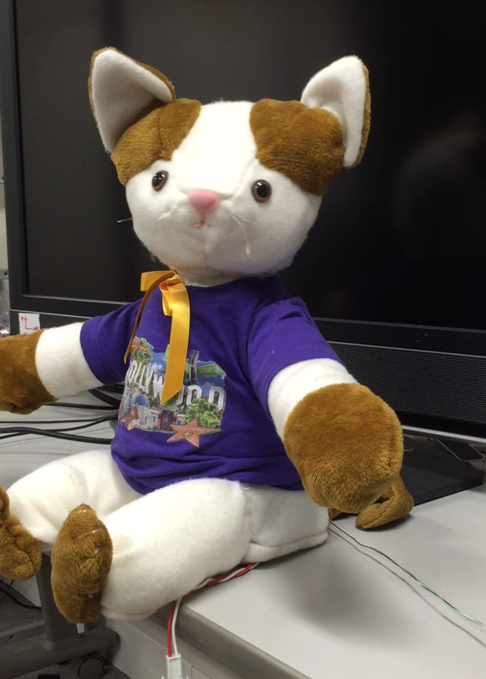
Thank You

