Slide 1


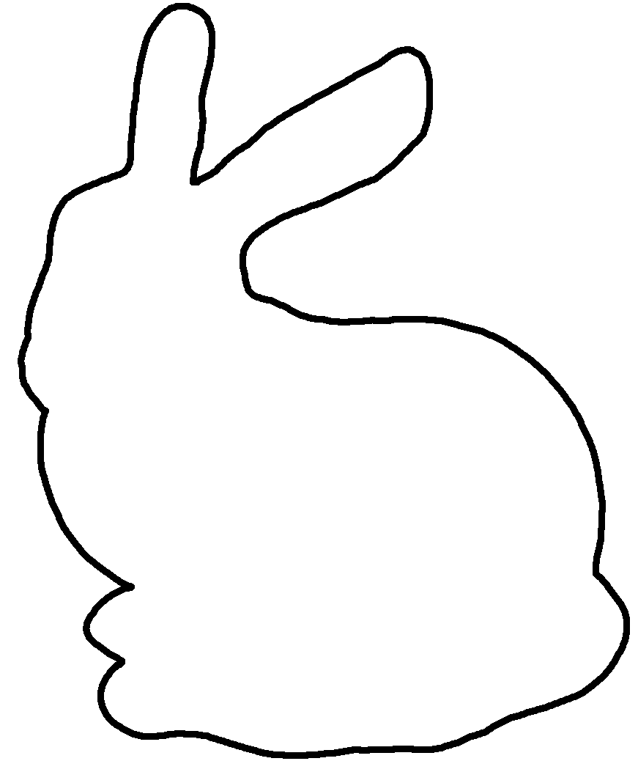
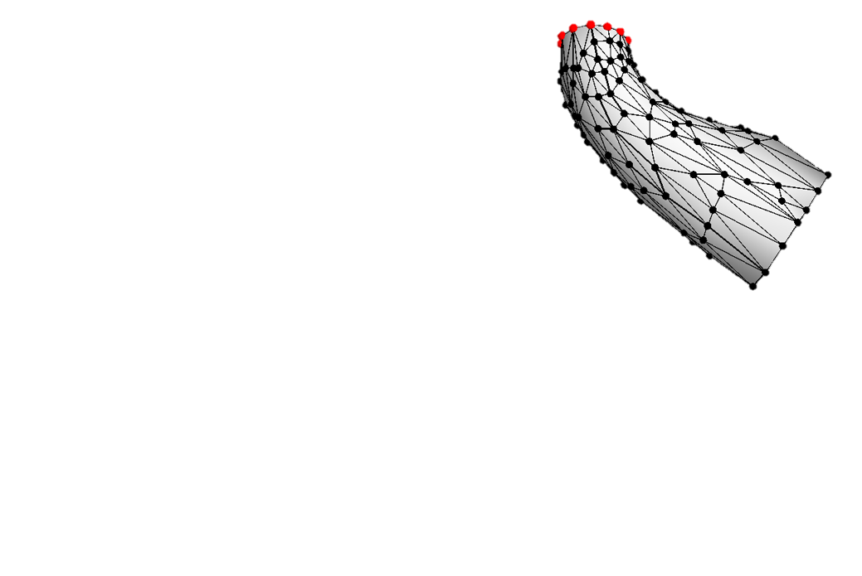
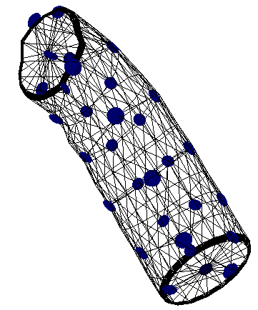
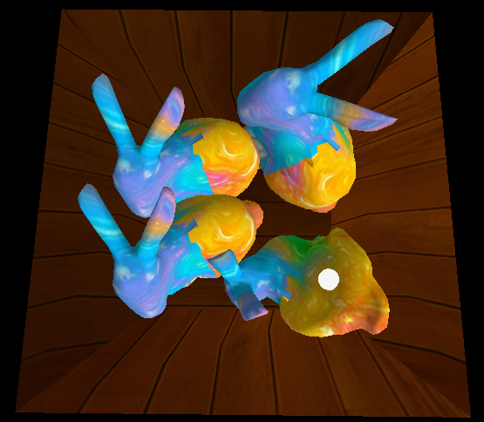
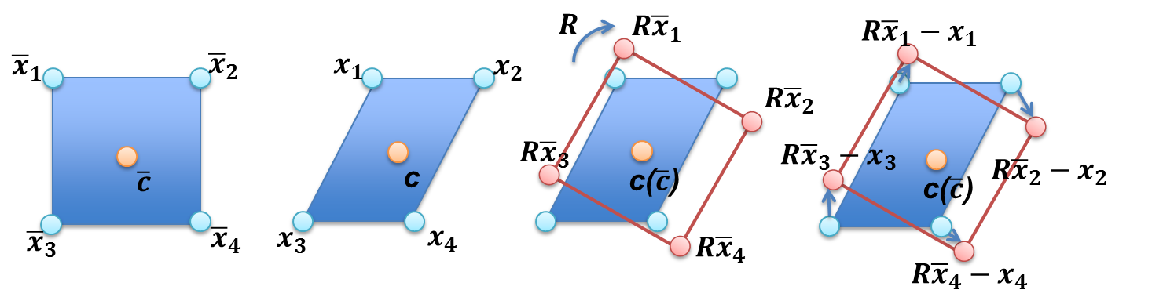
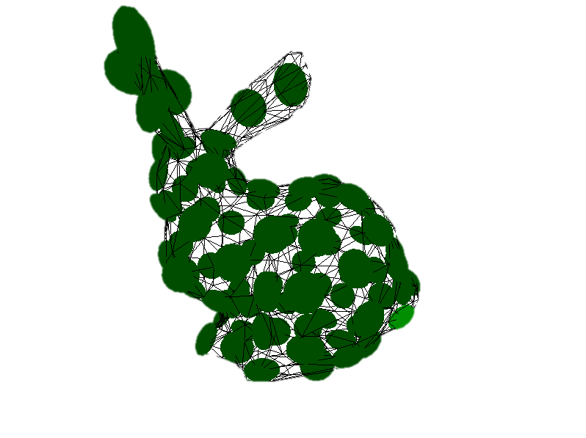
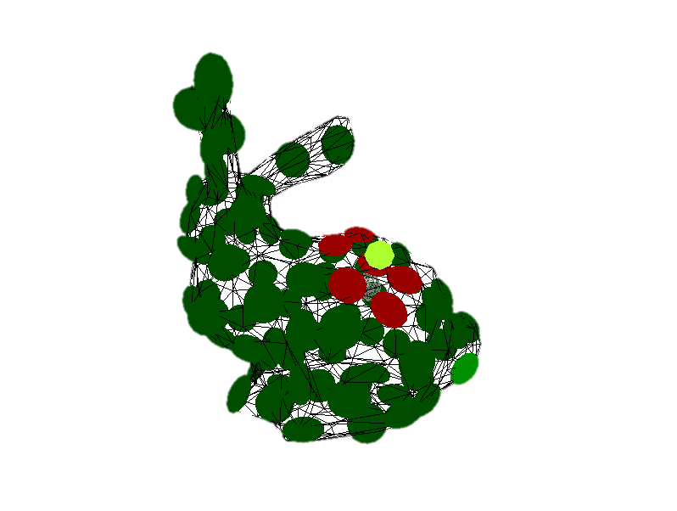
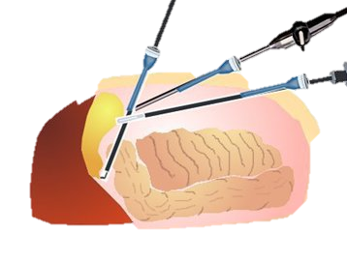
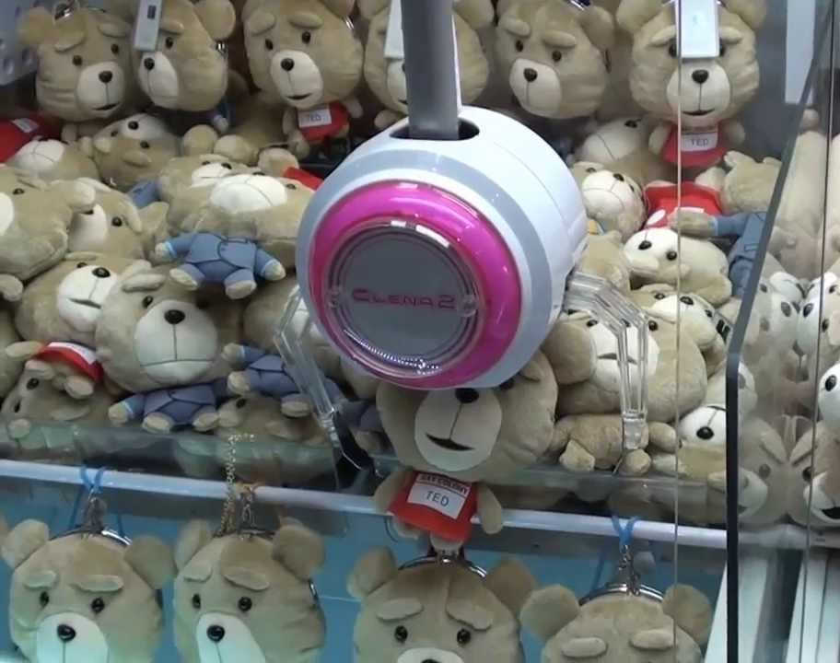


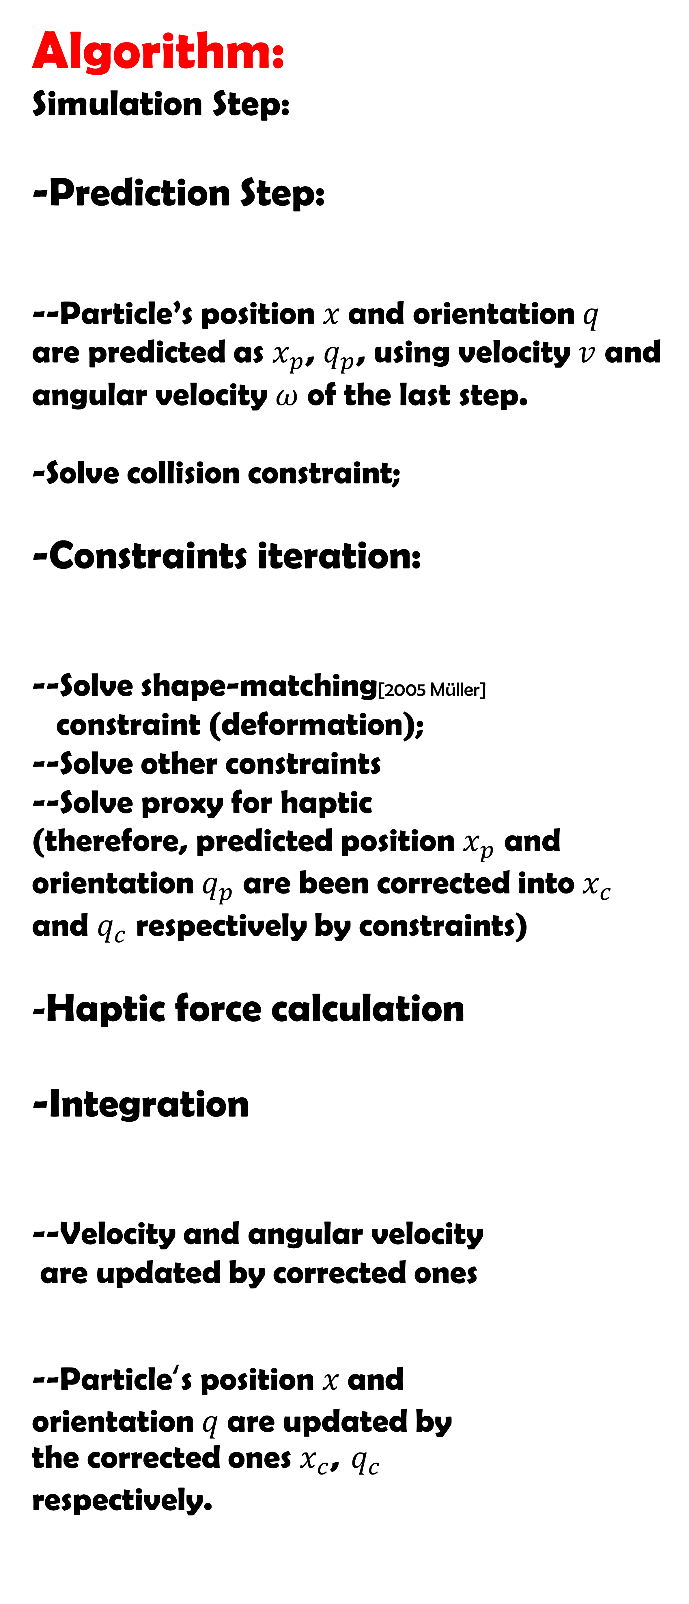
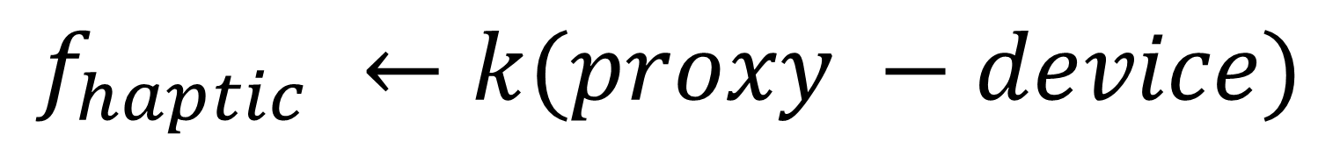
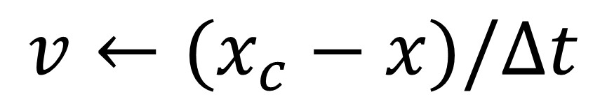
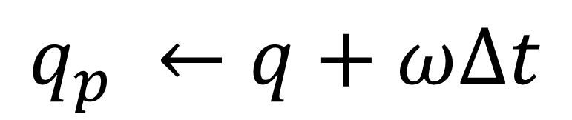
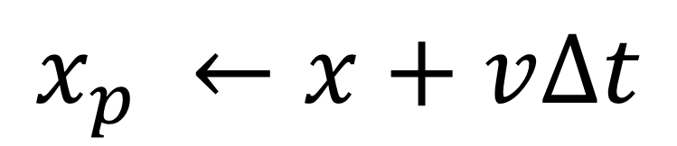


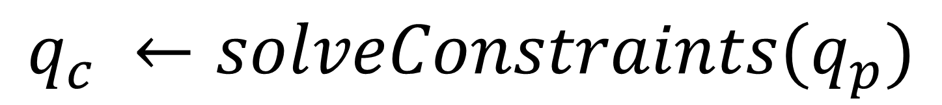

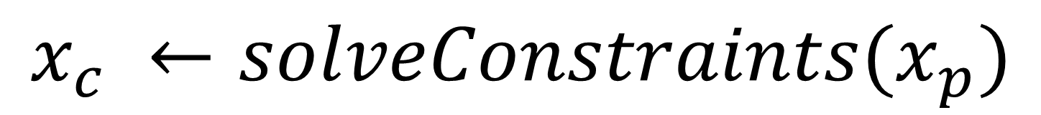
Tokyo Institute of Technology
Precision & Intelligence Laboratory
  Haptic Implementation on Deformable Objects based on Oriented Particles
Haiyang Ding, Hinorori Mitake, Shoichi Hasegawa.
1
Oriented Particles(OP) [2011 Müller] is a fast and robust geometric deformation method which is suitable for multi-soft object and robust simulation. Particles are grouped as a particle net for a model. One particle controls a certain numbers of model vertices.
3
2
Detailed haptic interaction:
By binding meshes to particle, we propose a two-layer collision detection for haptic proxy;
Particle collision
Local meshes collision
Algorithm:
Simulation Step:
-Prediction Step:
--Particle’s position $x$and orientation $q$
are predicted as $x_{p}$, $q_{p}$, using velocity $v$ and angular velocity $ω$ of the last step.
-Solve collision constraint;
-Constraints iteration:
--Solve shape-matching[2005 Müller]
constraint (deformation);
--Solve other constraints
--Solve proxy for haptic
(therefore, predicted position $x_{p}$ and orientation $q_{p}$ are been corrected into${ x}_{c}$ and $q_{c}$ respectively by constraints)
-Haptic force calculation
-Integration
--Velocity and angular velocity
are updated by corrected ones
--Particle‘s position $x$and
orientation $q$are updated by
the corrected ones $x_{c}$, $q_{c}$
respectively.
$$x_{p} ←x+v∆t$$
Bunny model is
assigned with
particles
Large deformation is
correctly performed
compare to linear-FEM
$$q_{p} ←q+ω∆t$$
1
layer
layer
2
Proxy
1
$$x_{c} ←solveConstraints(x_{p})$$
Original
Deformed
Particle
$$q_{c} ←solveConstraints(q_{p})$$
2
Match rotation
Shape matched
F
F
Shape-matching with multi- clusters
Device end-effector
Shape-matching algorithm
Multi-soft-body objects
interaction (only use CPU)
$$f_{haptic} ←k(proxy −device)$$
4
Future Work: 6-DOF rendering
Future Application:
Untouched
touched
$$v←(x_{c}−x)/∆t$$
Simulation Screenshot
$$ω←(q_{c}−q)/∆t$$
$$x←x_{c}$$
$$q←q_{c}$$
Soft-body Surgery Simulation. 1*
Multi-soft-object Haptic Game.
(UFO catcher) 1*
Presenter：Haiyang Ding
E-Mail: teikaiyo@haselab.net
1*. Pictures are from Internet
Notes:
Background : importance of this two

Slide 2
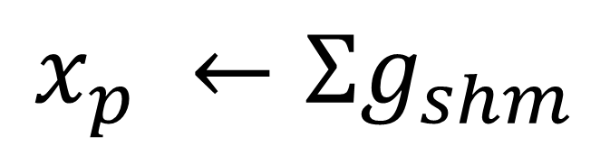
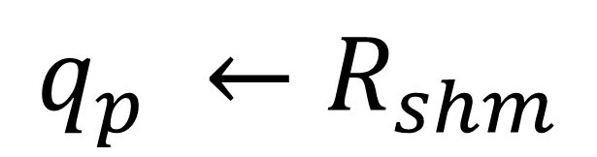
Tokyo Institute of Technology
Department of Computational Intelligence and Systems Science
  Haptic Implementation on Deformable Objects based on Oriented Particle
$$x_{p} ←Σg_{shm}$$
$$q_{p} ←R_{shm}$$
Oriented Particle :
Robust deformation
Fast
Rough collision
Multi-soft-body objects interaction (only use CPU)
1
outside
2
Soft-body Surgery Simulation
inside
Presenter：Ding Haiyang
E-Mail: teikaiyo@haselab.net
Notes:
Background : importance of this two

Slide 3
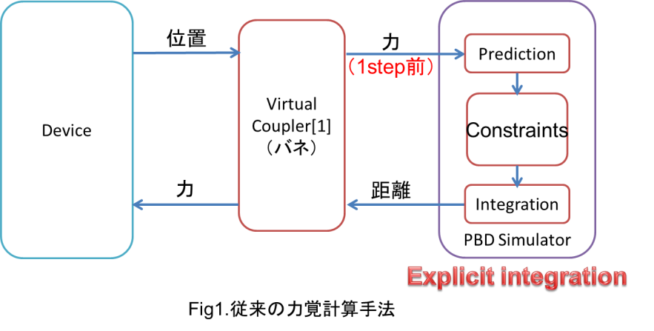
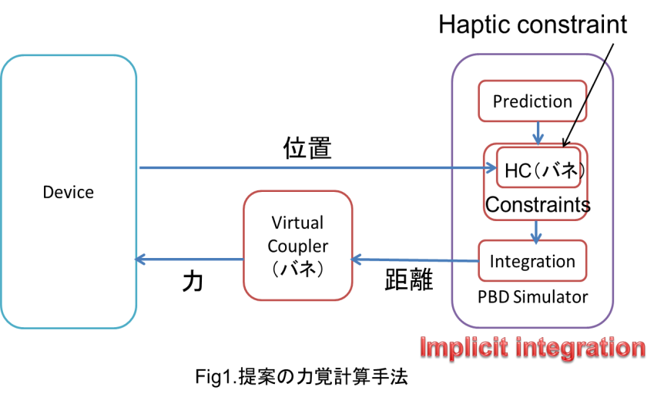
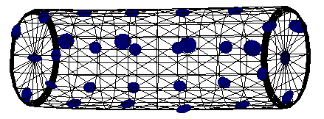
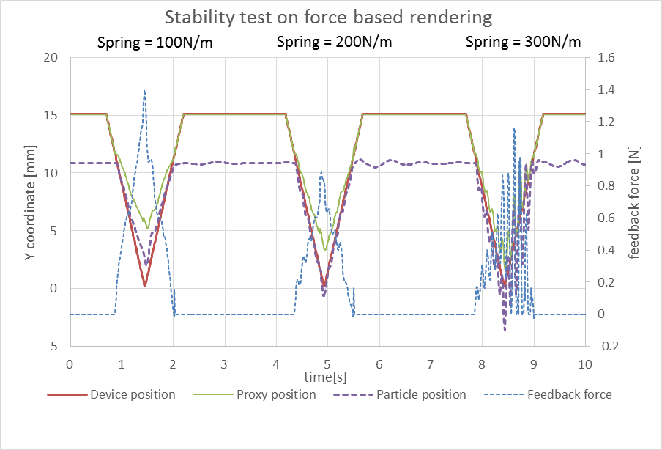
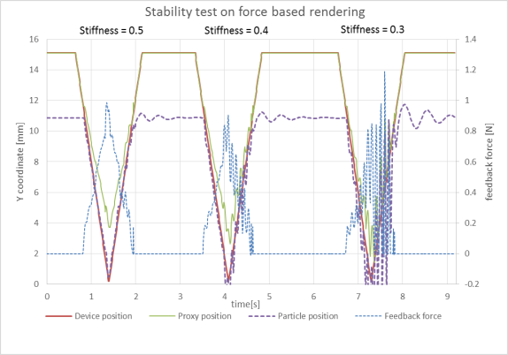
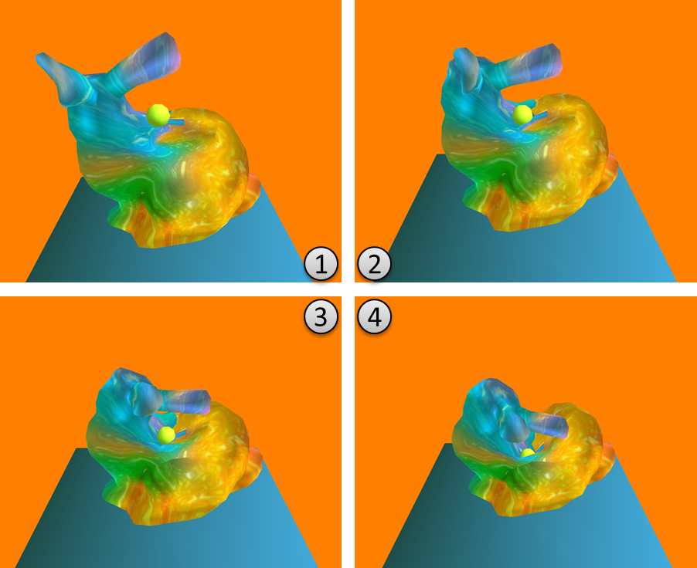
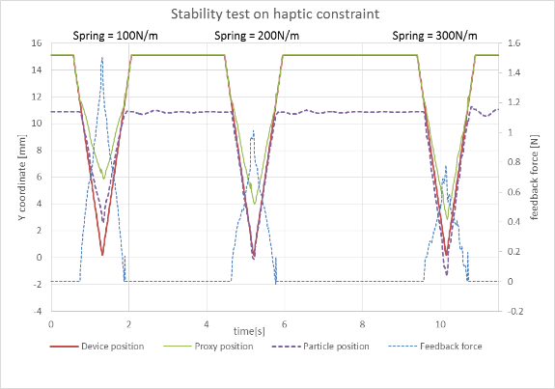
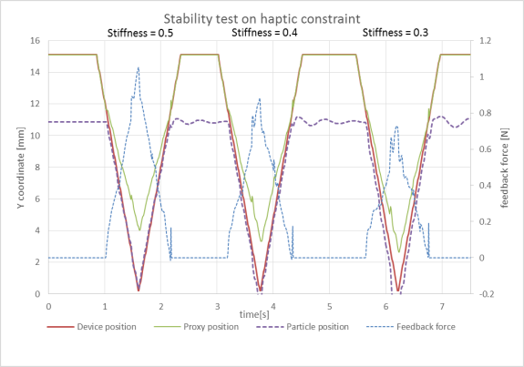
東京工業大学
総合理工研究科
知能システム専攻
研究タイトル：方向つき粒子による柔軟物の力覚レンダリング
  Research Title:
  Haptic Rendering for Deformable Objects based on Oriented Particle
リアルライム
計算が大変
柔軟体との力覚インタラクションシステム
例：手術訓練システム
計算量を減らすため、
高速な変形手法の
力覚レンダリング手法
を提案する
Position based dynamicsベースの
安定な力覚レンダリング
発振が収まった
大変形に対応
従来と提案の安定性評価
変形物との頑丈、安定なインタラクション
長谷川晶一研究室
発表者：Ding Haiyang
E-Mail: teikaiyo@haselab.net
Notes:
Background : importance of this two

Slide 4
particles
Proxy particle
Particle collision
1
Local Mesh
collision
2
Surface mesh
Haptic pointer

Slide 5
outside
inside

Slide 6
私は以下の時間帯には
必ずこのボードの前におります．
不在の場合は改めて来て頂ければ，
ポスター発表を行わせて頂きます．
I will be here during
１３：００ ～ １４：００ まで

Slide 7
私は以下の時間帯には
必ずこのボードの前におります．
不在の場合は改めて来て頂ければ，
ポスター発表を行わせて頂きます．
I will be here during
１４：００ ～ １５：００ まで

Slide 8
私は以下の時間帯には
必ずこのボードの前におります．
不在の場合は改めて来て頂ければ，
ポスター発表を行わせて頂きます．
I will be here during
１５：００ ～ １６：００ まで

