Slide 1
Short Paper:
Characteristics of Perception of Stiffness by Varied
Tapping Velocity and Penetration in Using Event-Based Haptic
Yuto Ikeda, Shoichi Hasegawa
The University of Electro-Communications

Slide 2
Background
Penalty based haptic rendering
⇒not stiff, not real
  Because of instability of control
  In conventional interfaces
  ⇒real-like stiff objects cannot be presented
F
x

Slide 3
Background
Event-based Haptic
  Adding physically-based vibration to the spring-damper model
  Vibrations are calculated off-line and presented when an event occurs
  ⇒ Easily applied to conventional haptic interfaces
Force
Vibration
Notes:
いべんと・・・提案されている、⇒説明

Slide 4
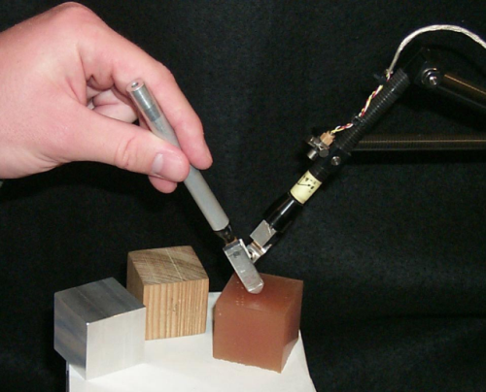


Related Work 1
Distinguish materials from vibrations
  “Reality-based models for vibration feedback in virtual environments.” Okamura et al.
  Imitate frequencies and envelopes of vibrations on real objects
  Subjects distinguished the differences in frequencies, envelopes as different materials
Wood
Aluminum
Notes:
人が材質を判別できる ← 周波数、エンベロープ（外形） 実物体に合わせて提示

Slide 5
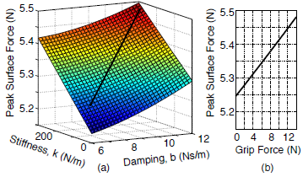
Related Work 2
Presentation of vibrations to increase realism in considerations of user’s operation
  “Shaping Event-Based Haptic Transients Via an Improved Understanding of Real Contact Dynamics”
  Fiene and Kuchenbecker
  Realism improves by changing the vibration amplitude according to the haptic pointers acceleration and gripping force
Gripping force small
Gripping force large
Notes:
握り方でリアリズム向上
振動の波形で説明

Slide 6
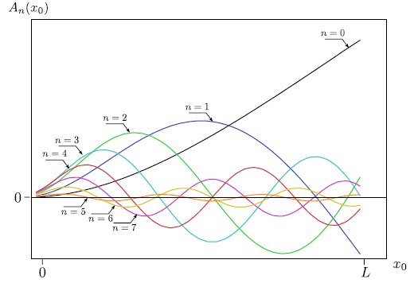
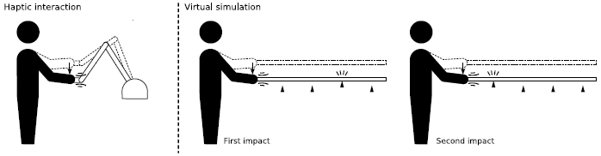
Related Work 3
Presenting different contact points through vibration pattern
  “Using vibration patterns to provide impact position information in haptic manipulation of virtual objects.” Sreng et al.
  Vibrations differ on different contact points
  Contact points are perceived differently by different vibration patterns
Notes:
片持ち梁の端（腹）を叩くと大きく振動する
手に近い部分（節）だと細かな振動が多く発生する
この振動のパターンによって人は接触点の違いを判別することができる

Slide 7
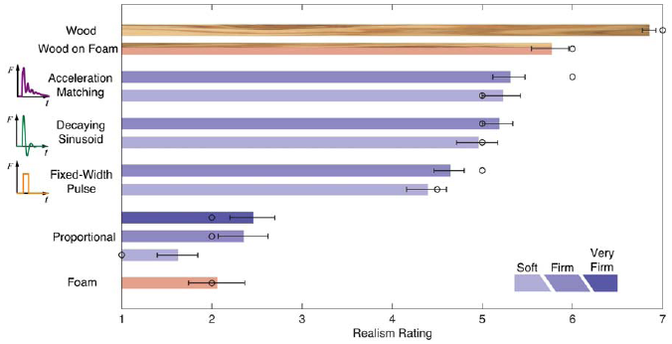
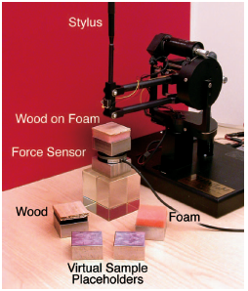
Related Work 4
Real-like material presentation is possible by vibration presentation
  “Improving contact realism through event-based haptic feedback”
  Kuchenbecker et al.
  Vibration is presented to increase realism
However,
  The sensation presented tends to be softer than the real thing
Notes:
振動の提示によってリアリズムのある提示が可能になる
またイベント・・・は材質そのものを提示するのではなく、やわらかいものに置かれた実物体に近い提示になる
これはhaptic を経験していくことでより知覚するようになる

Slide 8
Research Goals
Conventional Event-based Haptic research
  To improve and evaluate realism
  Evaluation on Event-based Haptic through stiffness is scarce
Our goals
  To evaluate the influences of Event-Based Haptic on stiffness perception
  To evaluate humans stiffness perception characteristics through presented vibrations
Notes:
硬さ尺度でこたえさせるが少ない
スタンフォード イベントベース サーベイ

Slide 9
Research Outline
Relation of spring, vibration and stiffness perception
  Ex.1: Evaluation of perception of stiffness
    Standard : vibration, re-presenting stiffness
    Comparison : non-vibration, altering spring coefficient
  Ex.2: Relation of penetration depth, velocity and stiffness perception
    Using the data recorded on the first experiment
Notes:
硬さ知覚の評価
（個人差やバラツキがあることがわかる）
↓
侵入量・・・

Slide 10
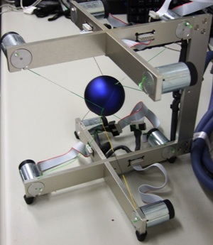
Experimental Environment
PC, WindowsXP OS,
Intel Core Duo T2300 1.66GHz CPU,
USB 2.0 port
Haptic Interface “SPIDAR-G”
SPIDAR-G
Notes:
今回の実験環境はこのようになっています
OS WindowsXPのPC、～のCPU、力覚インタフェースSPIDARにて提示を行い、PCとUSB2.0portにて接続を行う

Slide 11
Experimental Protocol
Perception of Stiffness with Vibration
The subjects tapped on a virtual surface
Standard : vibration (K=0.5, 1, 2 N/m)
Comparison : non-vibration
3 spring coefficient ×２ vibration type
×５ times＝30 trials/subject
Subjects: 7 persons
  Male
  Age : 22 ~26
Vibration A | -1500 | 90 | 300
Vibration B | -750 | 80 | 100
Notes:
実験は被験者にバーチャル床を叩いてもらう。振動のある床を叩き、振動のない床のバネ係数を同じだと思う硬さに調節してもらう
被験者は７人で、すべて男性、年齢は２２から２６歳である

Slide 12
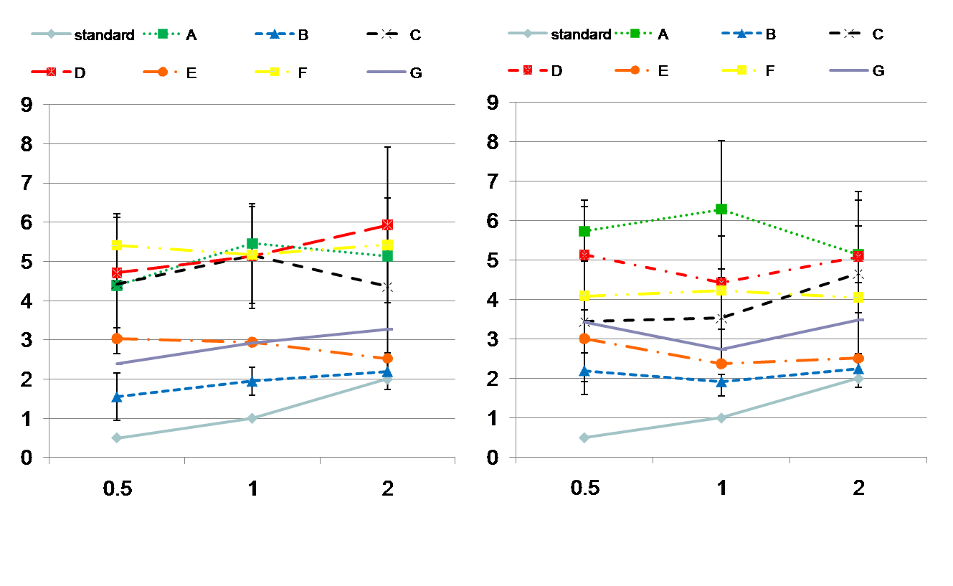
Result
Vibration A （ω：300Hz）
Vibration B （ ω ：100Hz）
Altered Spring coefficient [N/mm]
Standard’s Spring coefficient [N/mm]
Notes:
しっかり説明（1分）
軸、control（水色）、被験者７人、
バネ係数による右肩あがり、振動負荷による硬さ知覚、
個人差、ばらつき
dominant

Slide 13
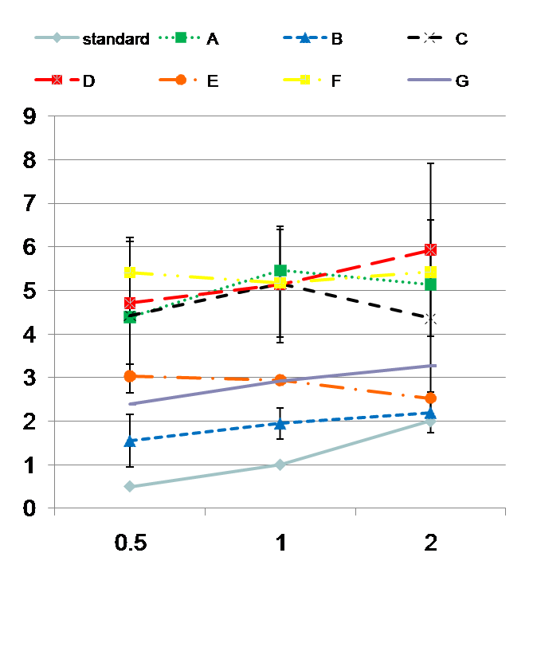
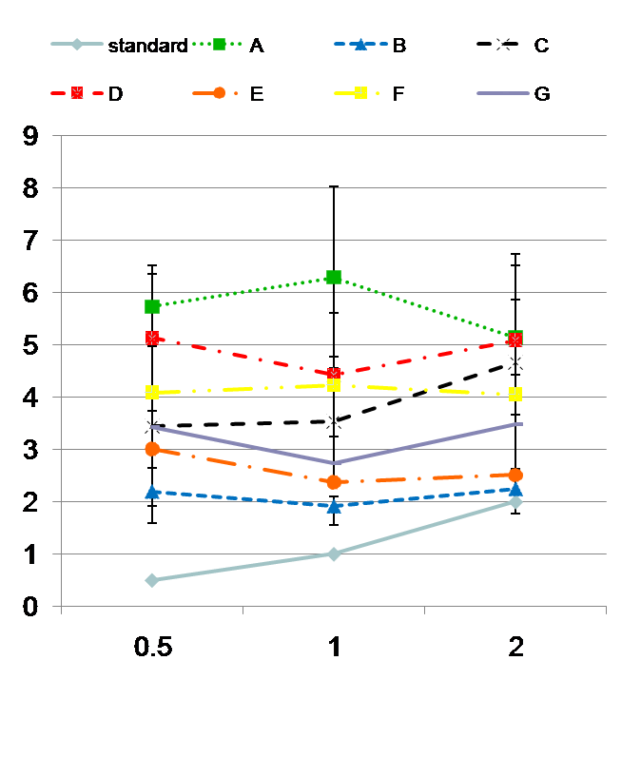
Result
Spring coefficient of the control
  higher ⇒ stiffer
Present vibration ⇒ stiffer
Data dispersion ＆ individual dispersion
  Subject “B” : slightly stiffer
  Subject “D” : very stiff
Vibration A （ω：300Hz）
Altered Spring coefficient [N/mm]
Vibration B （ ω ：100Hz）
Standard’s Spring coefficient [N/mm]

Slide 14
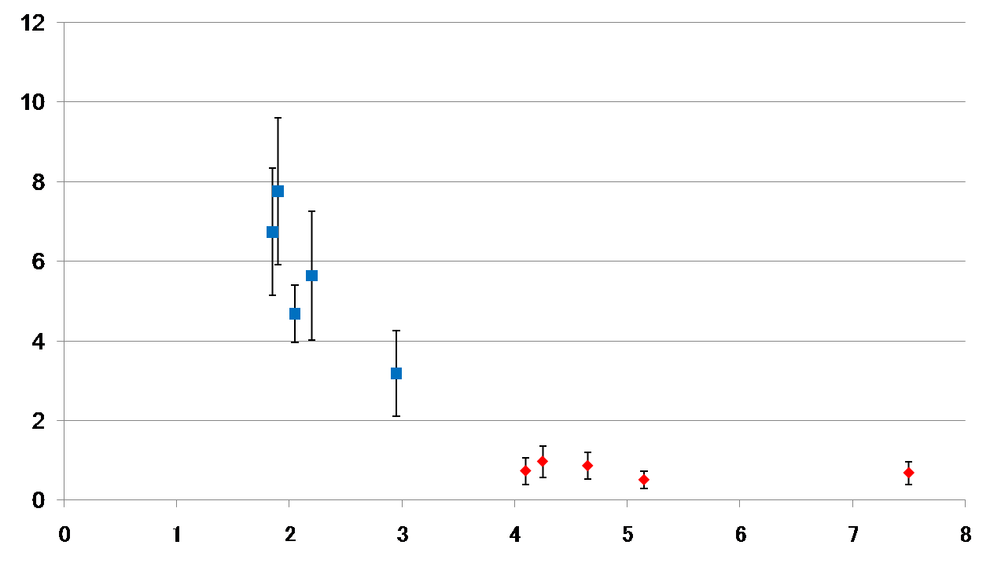
Penetration-Spring Coefficient
Vibration A, K=0.5(N/mm)
Subject “B”
Subject “D”
Penetration depth[mm]
Spring coefficient[N/mm]

Slide 15
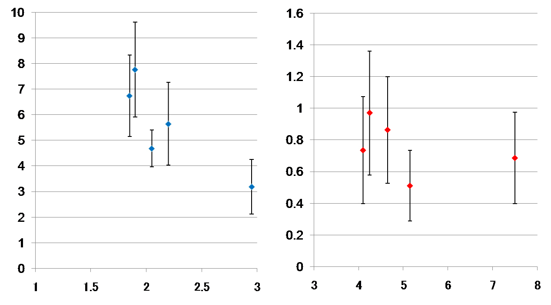
Penetration-Spring Coefficient
Vibration A, K=0.5(N/mm)
Subject “B”
Subject “D”
Penetration depth[mm]
Spring coefficient[N/mm]
Notes:
しかっり説明、状況
タッピング
振動A
回数 １０－２００

Slide 16
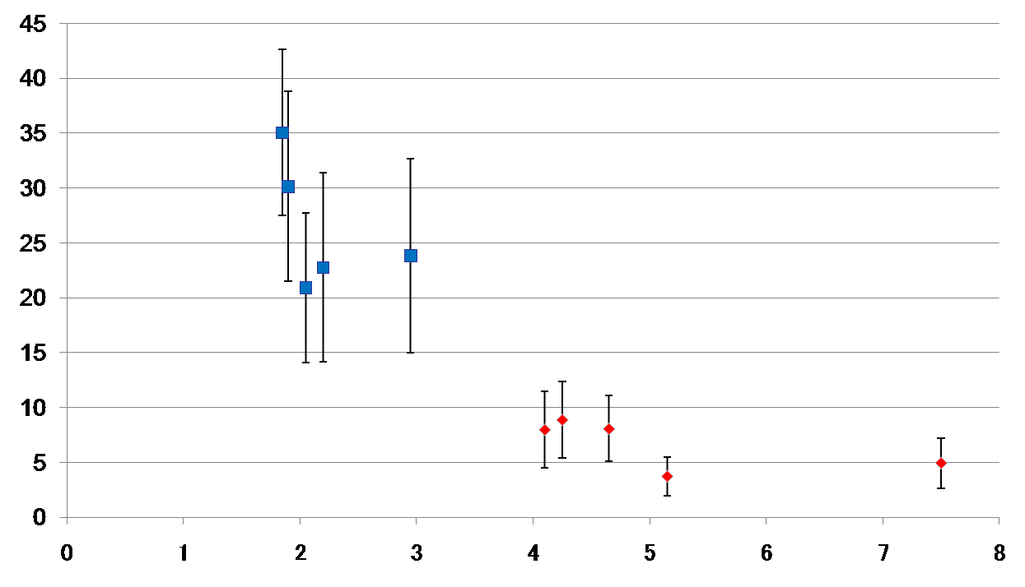
Velocity-Spring Coefficient
Vibration A, K=0.5(N/mm)
Subject “B”
Subject “D”
Velocity[mm/s]
Spring coefficient[N/mm]

Slide 17
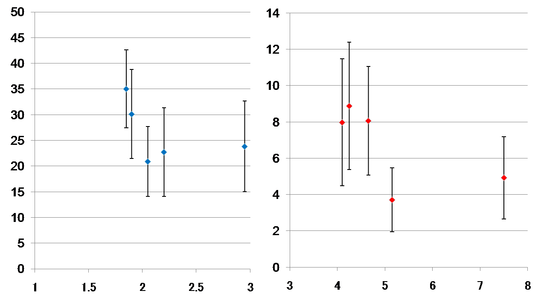
Velocity-Spring Coefficient
Vibration A, K=0.5(N/mm)
Subject “B”
Subject “D”
Velocity[mm/s]
Spring coefficient[N/mm]

Slide 18
Discussion
Penetration Depth
  Increase ⇒ spring is dominant
  Decrease ⇒ vibration is dominant
Tukey method test
  5％ of significant difference
Spring coefficient : high
Vibration is dominant
Spring coefficient : low
Spring is Dominant
Penetration depth low
Penetration depth high
Notes:
侵入量増 ⇒ バネメイン
減 ⇒ 振動メイン

Slide 19
Conclusions and Future work
Relation of spring, vibration and stiffness perception
  2 types of stiffness perception
Stiffness perception from vibration
  Unification of tapping speed ⇒ penetration depth control
Relation of stiffness perception from spring coefficient, penetration depth and penetration time
Effective applications in Haptic Interaction

